Slide 2
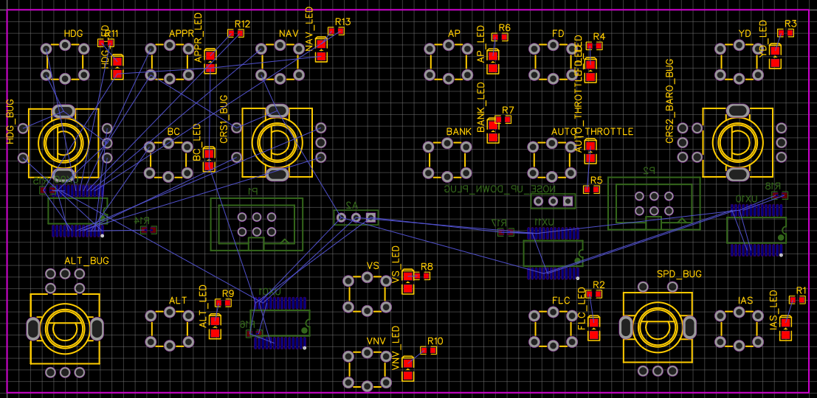
PDF/MFD multi
PDF/MFD multi
PFD
Pages
GOTO
FPL
CLR
RK
PFD
Pages
GOTO
FPL
CLR
RK
MFD
MENU
PROC
ENTER
MFD
MENU
PROC
ENTER
RADIO
RADIO
Radio
Radio
COM FREQ
SWAP
Radio
SWAP
NAV FREQ
COM FREQ
SWAP
Radio
SWAP
NAV FREQ
MODE
MODE
COM3, ADF, DME…
MODE
MODE
COM3, ADF, DME…
COM
COM
A
MRKR MUTE
NAV2
A
MRKR MUTE
COM1
COM2
COM3
NAV1
NAV2
A
MRKR MUTE
NAV2
COM1
COM2
COM3
NAV1
VOLUME/SQ
COM1
COM2
COM3
NAV1
O
VOLUME/SQ
VOLUME/SQ
O
SENS
MIC1
MIC2
MIC3
DME
ADF
O
M
SENS
MIC1
MIC2
MIC3
DME
ADF
SENS
MIC1
MIC2
MIC3
DME
ADF
M
M
AP
AP
HDG
APR
NAV
AP
FD
YD
HDG
APR
NAV
AP
FD
YD
HDG
BC
CRS1
BANK
AT ?
CRS2/ BARO
HDG
BC
CRS1
BANK
AT ?
CRS2/ BARO
ALT
ALT
VS
FLC
SPD
IAS
ALT
ALT
VS
FLC
SPD
IAS
VNV
VNV
LIGHT
DIMM
LIGHT

Slide 3
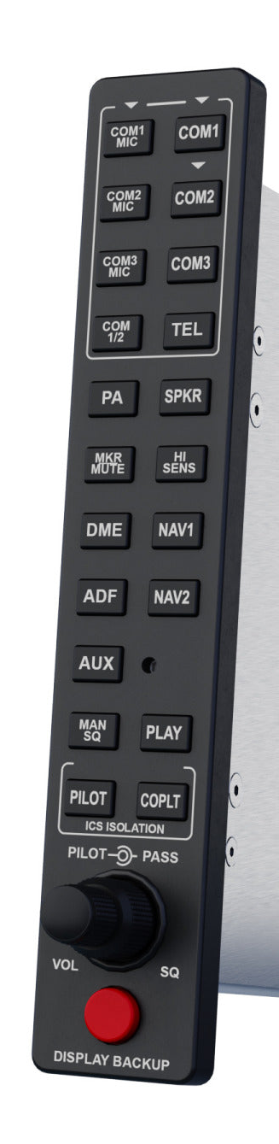
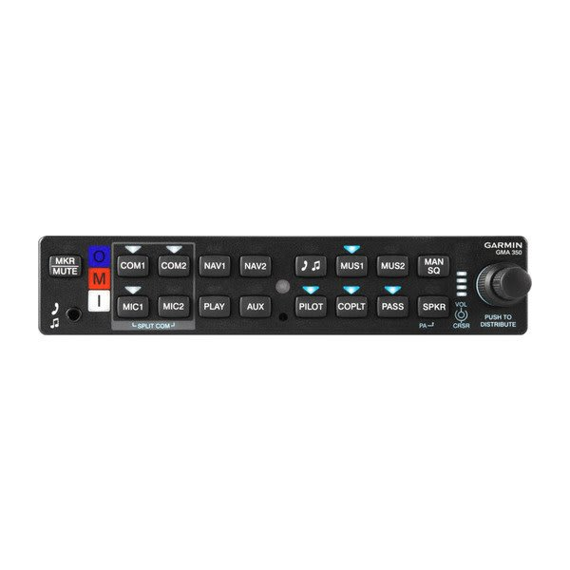

Slide 4
NAV ACTIVE FREQUENCY:index
COM ACTIVE FREQUENCY:index
COM1 STORED FREQUENCY
NAV STANDBY FREQUENCY:index
COM STANDBY FREQUENCY:index
NAV1
COM1
NAV IDENT, NAV NAME
121.40
114.70
120.750
121.408
COM ACTIVE FREQ IDENT:index/COM ACTIVE FREQ TYPE:index
NAV RADIAL/NAV VOR DISTANCE
183° 83NM
RBT
LFPN TWR
183° 83NM
COM ACTIVE BEARING:index/COM ACTIVE DISTANCE:index
TYPE : ILS, VOR, VORDME
NAV2
COM2
121.40
115.65
121.408
121.408
EPR
TX
NAV ACTIVE FREQUENCY:index
NAV STANDBY FREQUENCY:index
ADF IDENT
ADF
121.40
115.65
NAV RADIAL/NAV VOR DISTANCE
183° 83NM
EPR
COM AVAILABLE:index : pour paramétrer système
COM SPACING MODE:index
https://docs.flightsimulator.com/html/Programming_Tools/SimVars/Aircraft_SimVars/Aircraft_RadioNavigation_Variables.htm

Slide 5
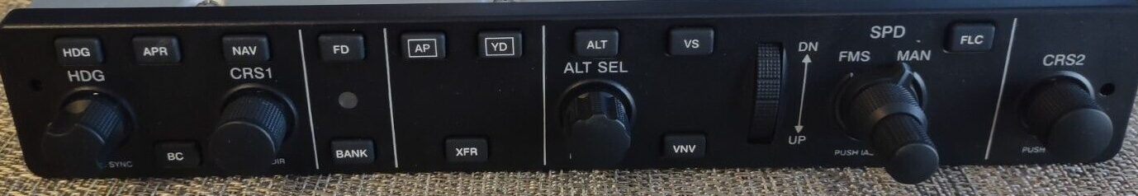
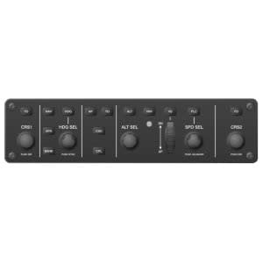
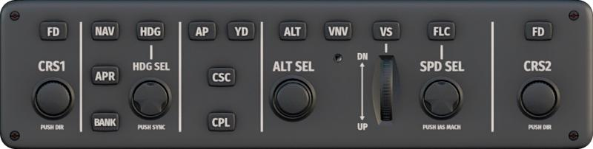
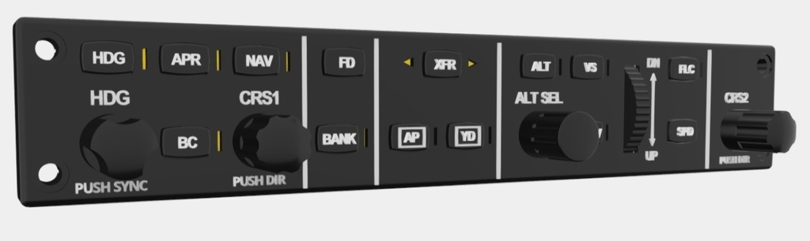
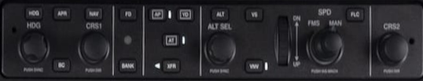
To scale
AP
HDG
APR
NAV
AP
FD
YD
HDG
BC
CRS1
BANK
AT ?
CRS2/ BARO
ALT
ALT
VS
FLC
SPD
IAS
VNV

Slide 6
F-18 DDI
TLA 180 60 Vert
3,4V max
30 mA (100mA peak)
Arduino Nano

